Slide 1
Admin

Slide 2
week 1
wut?

Slide 3
what is stats?

Slide 4
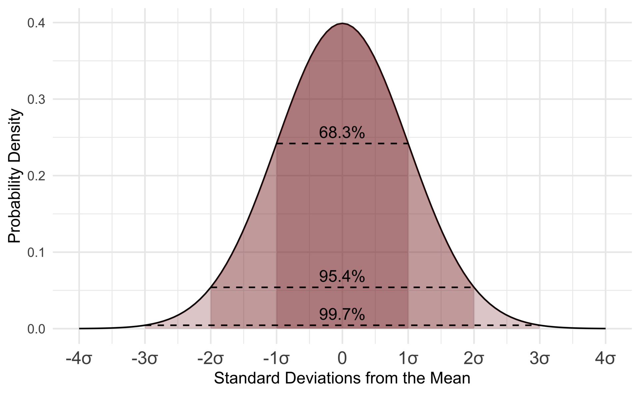
Notes:
DATA refining
DATA mining
We gather qualities at scale and find insights with them about a population.
We can say there are 3 large hats.

Slide 5
describe
Notes:
Descriptives essentially take pieces of data and refine it in such a way as to turn it into information we can use. We tend to begin with a number of measures sometimes referred to as summary stats or modes of central tendency: (mean, median, range, and standard deviation).
Mean is the average, median is the middle most point, range is lowest to highest value, and standard deviation describes how much variance is within the set of data. Think of it sort of like a weather person talking about average temperatures, what the high and low will be, how today differed from yesterday but also the same day last year.
While these data are useful, folks will tend to react to raw values in different ways. As such, there are also ways to show these values graphically by using things like Boxplots, histograms, pie charts, Pareto charts, and many others. One last way to think about these descriptives or summary stats is that they show us what sort of distribution we have (i.e., Poisson, binomial, normal). In the end, we cannot really make inferences from here, not actual ones anyway. We can make useful guesses as to trends, but we need more methods to take us from description to inference.

Slide 6
compare

Slide 7
relate

Slide 8
how does it work?

Slide 9
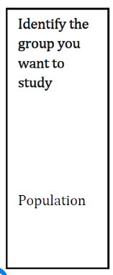

Slide 10
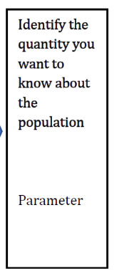
Quality

Slide 11
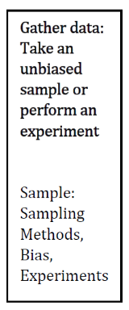

Slide 12
can we be unbiased?

Slide 13
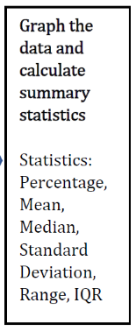

Slide 14
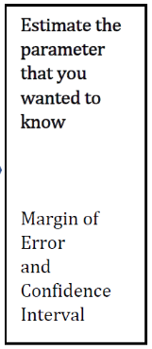

Slide 15
what does any of that mean?

Slide 16
what has stats done for us?
Notes:
Social Class
Problems related to systemic issues as seen from the ethnicity variable
Averages
Stock Market
AI/ML
Robocalls!
Transportation
Advertising
Marketing
Cambridge Analytica!
The average drunk driver drives under the influence more than 80 times before being arrested the first time.
One-third of adults still sleep with a comfort object.
The global rate for washing hands after using the toilet is under 20 percent.
Americans read for personal interest for 10 minutes or less per day.
More than 36 million U.S. adults cannot read above a third grade level.
And more than half a million people in America experience homelessness a night.
Nearly a quarter of rural Americans say access to high-speed internet is a "major problem" in their community.
On an average day, only 19 percent of American men do housework—as compared to 49 percent of American women.
Each 5 m.p.h. you drive over 60 m.p.h. is like paying an additional $.10 a gallon for gas.
Jumbo jets use 4,000 gallons of fuel to take off.
93% of all people will verify things they see online (or in class).
If the oldest living person is 115 years old, then 116 years ago there was a totally different set of humans on earth.
95% of the ocean and 99% of the oceans floor remains unexplored
The average person in Canada has a higher net worth than the average person in the USA. The median income for Canadians is about twice the median income for Americans.

